Slide 1
HPS Ecal and vacuum chamber design
1- Vacuum chamber proposal
1.1- Stainless steel chamber design and calculations
1.2- Aluminum chamber design and calculations
2- Ecal Crystal support frames
2-1- design
2-2- calculations
3- Ecal assembly design
3-1 Ecal frames and vacuum chamber
3-2 Ecal frame supports principle
3-3 Enclosure + pcb

Slide 2
Vacuum chamber design

Slide 3
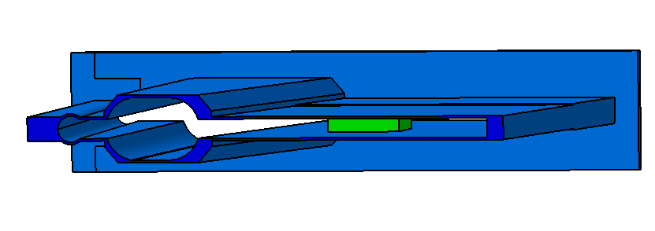
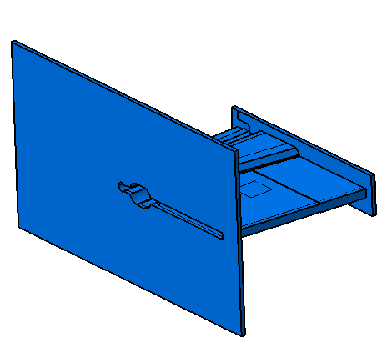
Stainless steel vacuum chamber design
3 mm
Honneycomb pillar
2 mm
2 mm
10 mm
10 mm

Slide 4
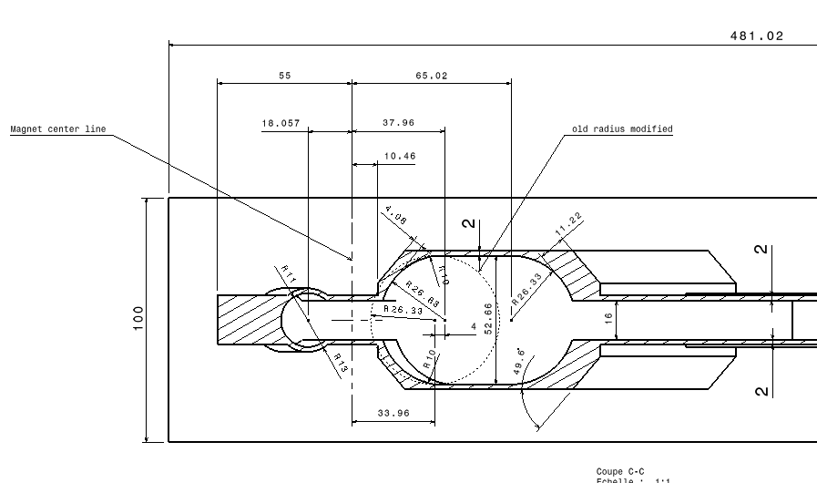
Stainless steel vacuum chamber dimensions: front cut view
Internal shape in conformity with Jlab information except electron Left hole shifted of 4 mm to right ,elliptic shape R 26.63

Slide 5
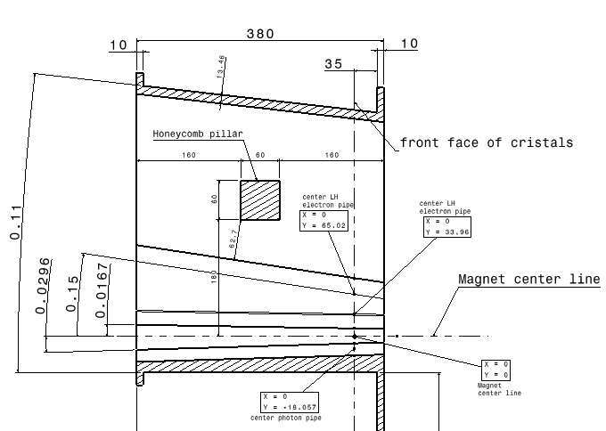
Stainless steel vacuum chamber dimensions: top cut view

Slide 6
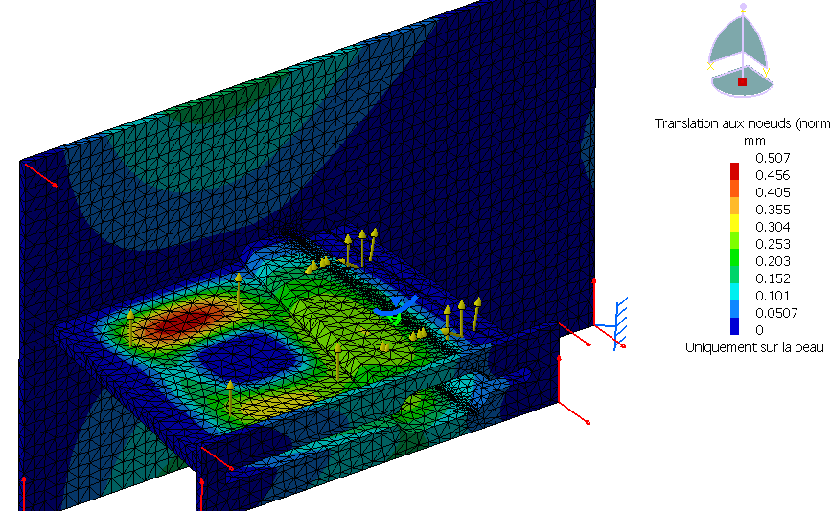
Stainless steel vacuum chamber calculation: deformations

Slide 7
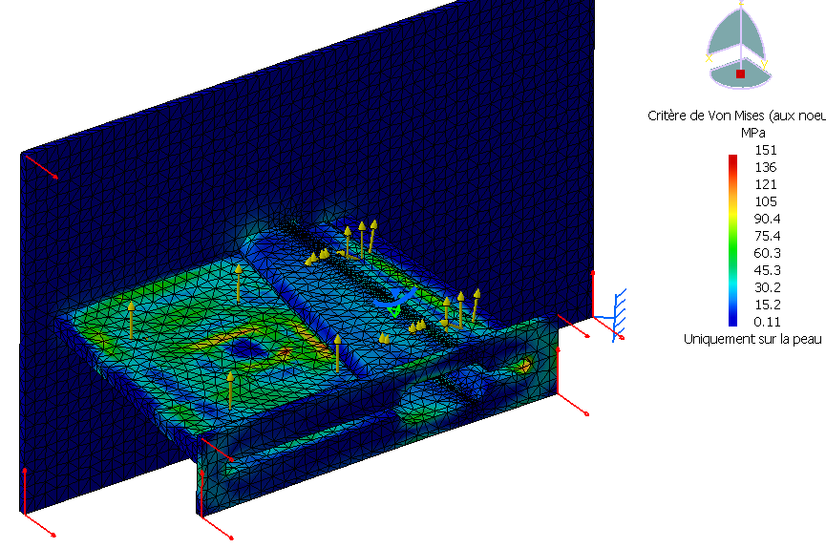
Stainless steel vacuum chamber calculation: stress
Stainless steal: 304 L WN 1.4306.
Rp0,2 Elastic Strength = 200 Mpa
Rm (Critical Strength) = 500 Mpa
Norm CODAP (Pressure vessel)
Max 2/3 Rp 0.2 = 140 Mpa
Stress max 151 Mpa due to corner of pillar are singularity of calculation and not representative
Max real stress = 130 Mpa

Slide 8
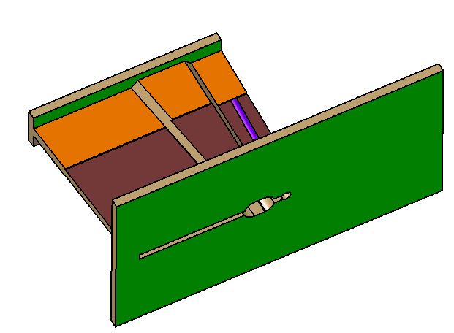
Aluminum vacuum chamber design
Thickness : 6mm
Thickness : 2mm
Thickness : 3mm
Thickness : 20 mm

Slide 9
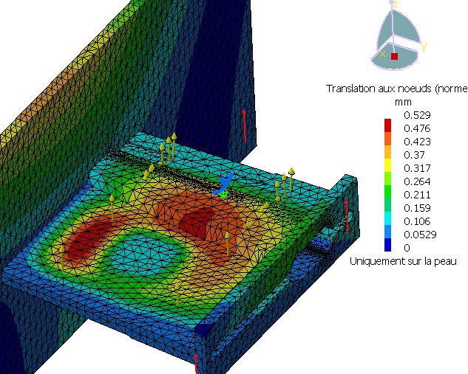
Aluminum vacuum chamber calculation: deformations
Pressure calculated on Honeycomb = 0.97Mpa
Crush strength of Aluminum honeycomb
ECM 3.2-130 (Euro composite)=3.38 Mpa

Slide 10
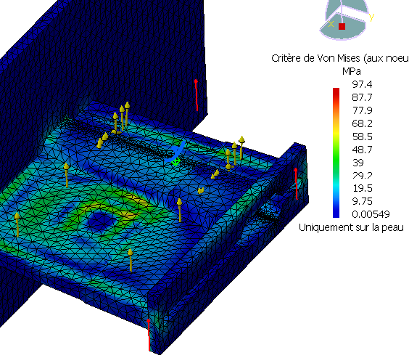
Aluminum vacuum chamber calculation: stress
Aluminum 5083
Rp 0.2 =130 Mpa
Rm = 260 Mpa
Max 2/3 Rp 0.2 = 85 Mpa
Stress max 97 Mpa due to corner of pillar are singularity of calculation and not representative
Max real stress = 70 Mpa

Slide 11
Conclusions about the 2 vacuum chamber design proposal
The 2 chambers follow the design rules (french CODAP for pressure vessels)
But…
From the mechanical point of view , stainless steel is better :
In terms of manufacturing and welding (more common in industry)
2) The rear side of the horizontal plates of 3 mm (instead 6mm Aluminum) gives a bigger gap for cooling tubes, insulation and preamps
Simulations must also show results with steel

Slide 12
HPS Ecal frames design

Slide 13
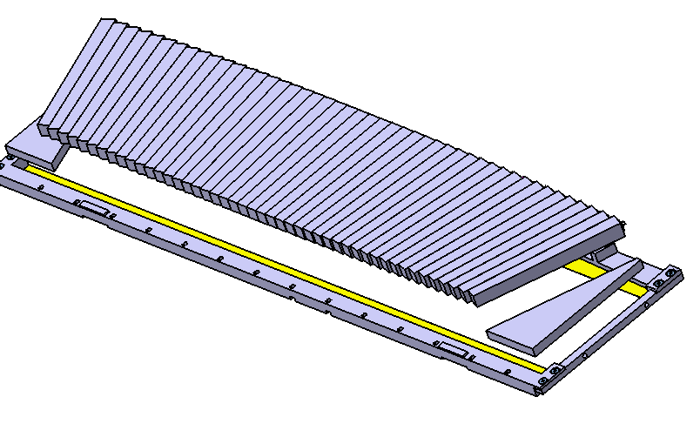
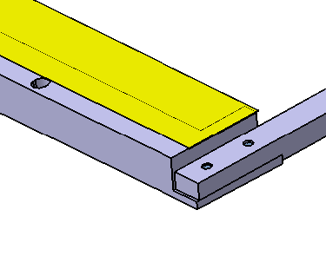
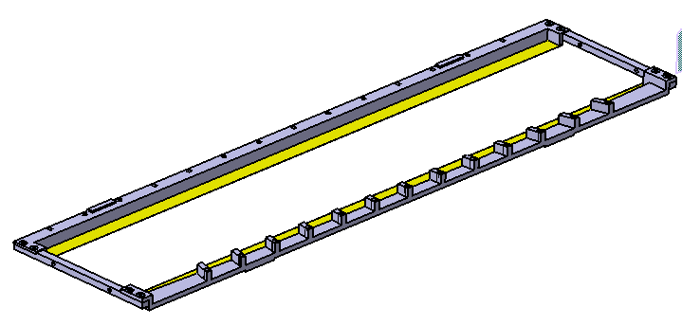
Crystal support frames design
Same design as DVCS but simplified (rectangular)
2 spacers to block them
46 crystals on a line
2 metal sheets (thickness= 0,12mm) tensed and glued on the frames

Slide 14
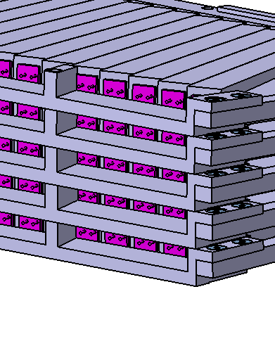
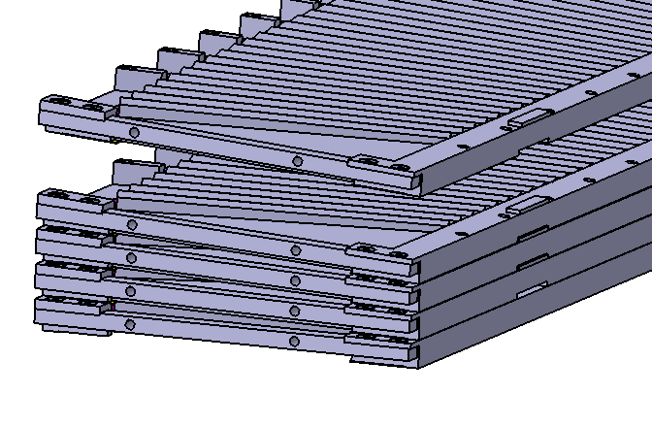
Crystal support frames stacking (1)
The frames are stacked one by one (APD control at each line)

Slide 15
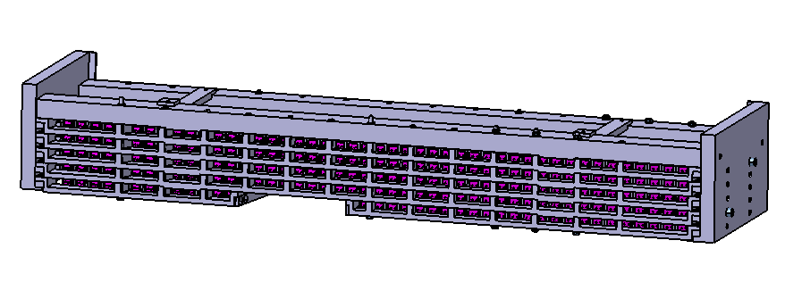
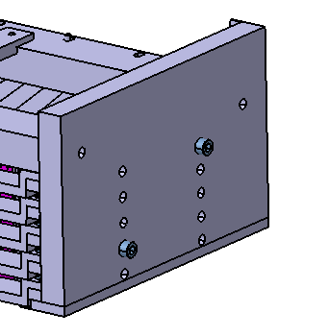
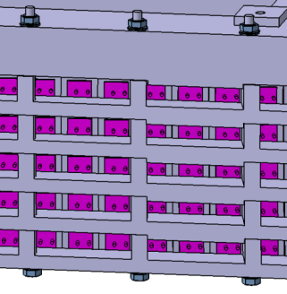
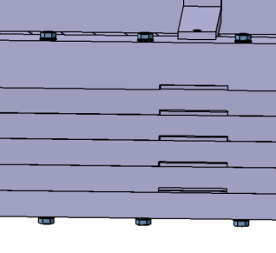
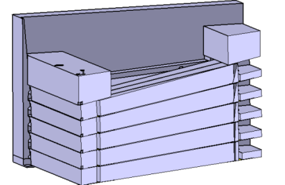
Crystal support frames stacking (2)
The frames are clamped with screws
2 beams added to give more inertia at the assembly
Each side is clamped with a strong support plate
1 3 Screws on each frame
rear frames
front frames
front adjustment of the frames

Slide 16
Crystal support frames calculations
D max =0,042mm
Front frames
Stress max :12Mpa
D max =0,07mm
Rear frames
Stress max :18Mpa

Slide 17
Assembly design

Slide 18
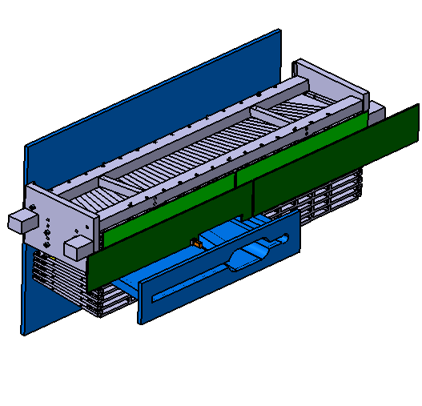
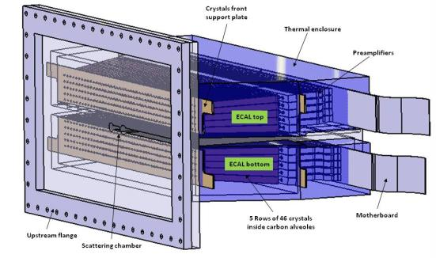
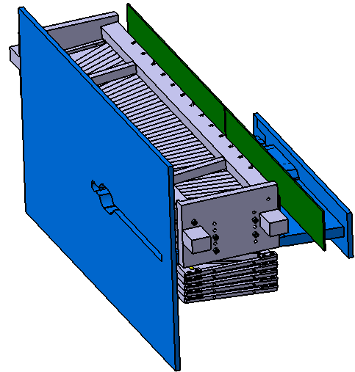
The vacuum chamber with the ECAL

Slide 19
Top and bottom ECAL independent adjustment
Adjustment system for each block
Support

Slide 20
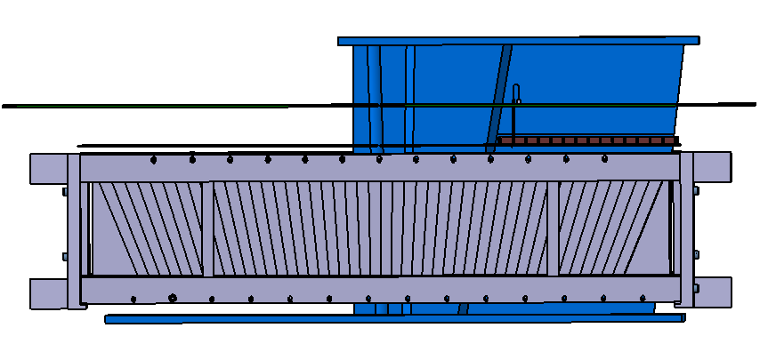
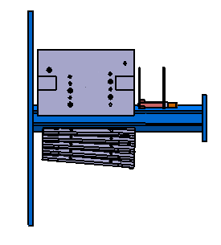
The vacuum chamber with the ECAL: top view

Slide 21
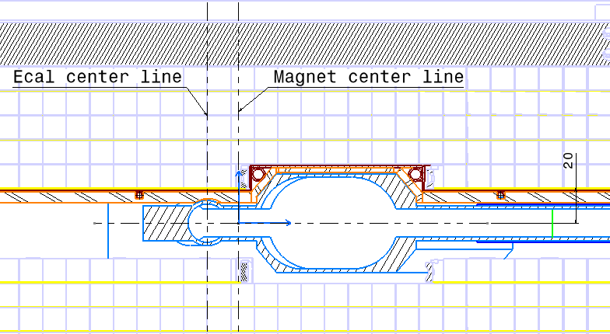
The vacuum chamber with the ECAL: front cut view

Slide 22
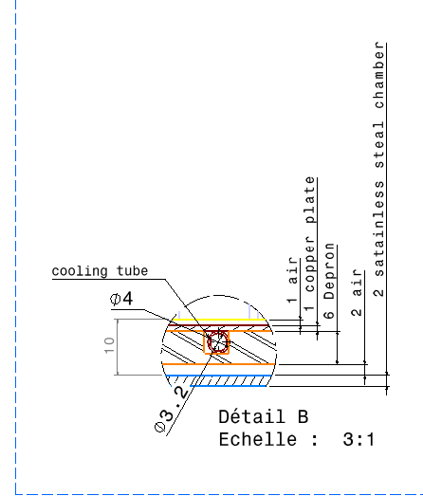
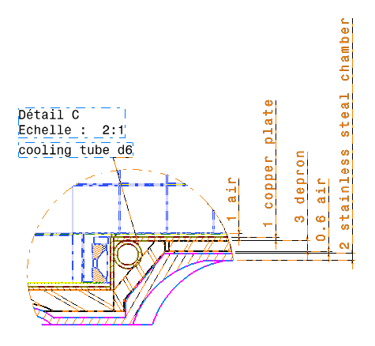
Detail of the gaps between ECAL and chamber

Slide 23
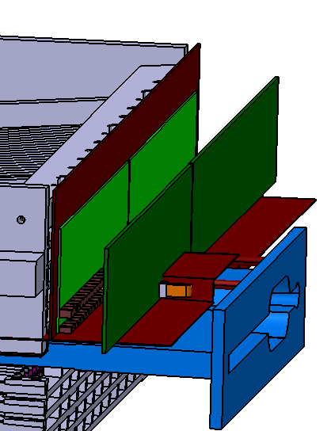
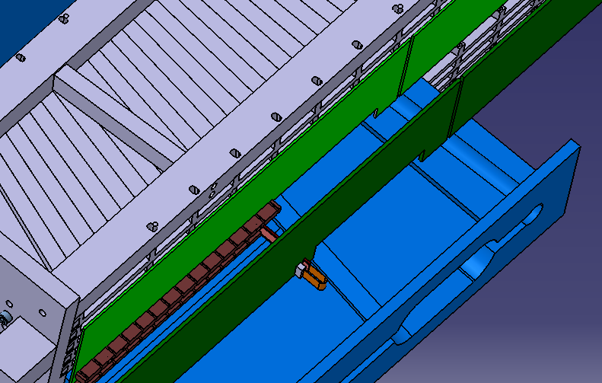
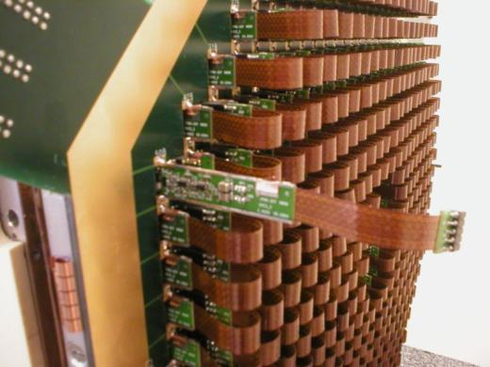
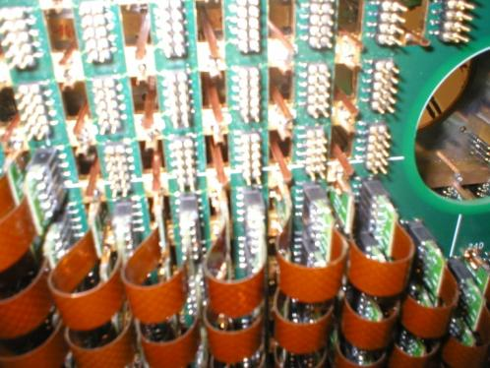
Connection to the preamps and read-out
2 Connection board R + L
2 mother board R + L
PCB
Copper plate
Connection similar to DVCS

Slide 24
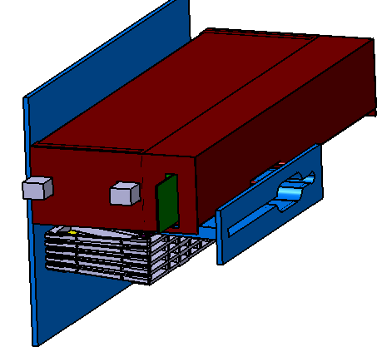
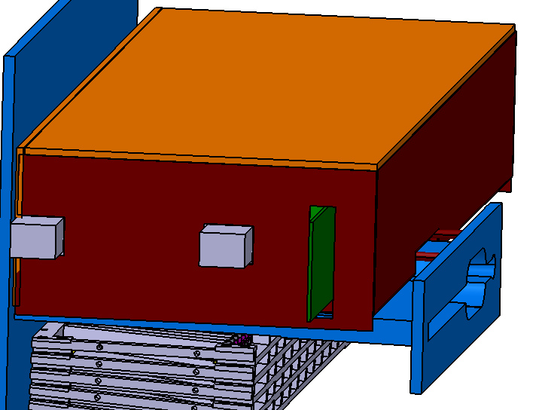
Thermal enclosure
Copper plates with cooling tubes around the Ecal
6 mm foam for insulation

